Slide 1

Florida Atlantic University
Project Title: Breast Cancer Stage Classification with miRNA
Project Members: Group #44
Joshua Adegboyo: jadegboyo2023@fau.edu
Anika Baro Villa: abarovilla2021@fau.edu
Nicholas Campos: ncampos2022@fau.edu
Brehon Parker: bparker2012@fau.edu

Slide 2
Objective & Approach
Problem
Current breast cancer staging depends on invasive biopsies; miRNA profiles could aid diagnosis with no extra procedures.
Challenges: 1,881 features, limited samples, and inconsistent feature-selection outputs reduce reliability.
Goal
Derive stage-specific miRNA panels and compare traditional, deep-learning, and clustering methods.
Assess accuracy and interpretability under class imbalance and stage heterogeneity.
Innovation
Stage-wise study: 12 feature-selection methods across 3 families.
Consensus panels: majority vote + intersection to stabilize selections.
Practical validation: 70/30 stratified split for Stages I–III; stratified 5-fold CV for
Stage IV (only 15 positives), with imbalance-aware training.

Slide 3
What has been done?
📊
Data Preprocessing
Downloaded 1,209 TCGA breast-cancer miRNA files (GDC)
Extracted RPM-normalized expression (reads_per_million_miRNA_mapped)
Linked to clinical metadata via case_id (maps each expression file to the correct patient)
Standardized stage labels (collapsed sub-stages, encoded 0–4)
Final dataset: 1,209 samples × 1,881 miRNAs with stage labels
🗂️
Stage-wise Feature Selection
Traditional: SFS, VT, Chi², LASSO (top-5/10/15)
Deep Learning: FNN, DAE, 1D-CNN, LSTM-Seq (top-5/10/15)
Clustering: KM, SC, GMM, HC (2 clusters; variable-sized selections)
Outputs: 112 ranked miRNA lists | 3 approaches × 4 stages
All files validated (header, duplicates, empty checks passed)
👥 1,209 Samples (Patients)
🧬 1,881 miRNAs (Features)

Slide 4
What has been done?
🔗
Stage-wise Consensus miRNA Panel Generation
Consensus rules: Intersection (all 4 agree), Majority (≥2 agree)
Applied per family per stage (Traditional, Deep Learning, Clustering)
Low intersection reveals high method variability
✅
Stage-wise Classification Evaluation
Classifiers Trained: RF, SVM-linear, LR, KNN (balanced class weights)
Validation Approach: 70/30 stratified split (I-III) | stratified 5-fold CV (IV; only 15 positives)
Metrics Computed: Accuracy, Sensitivity, Specificity, AUC
Evaluated both consensus rules (intersection + majority)
👥 1,209 Samples (Patients)
🧬 1,881 miRNAs (Features)

Slide 5
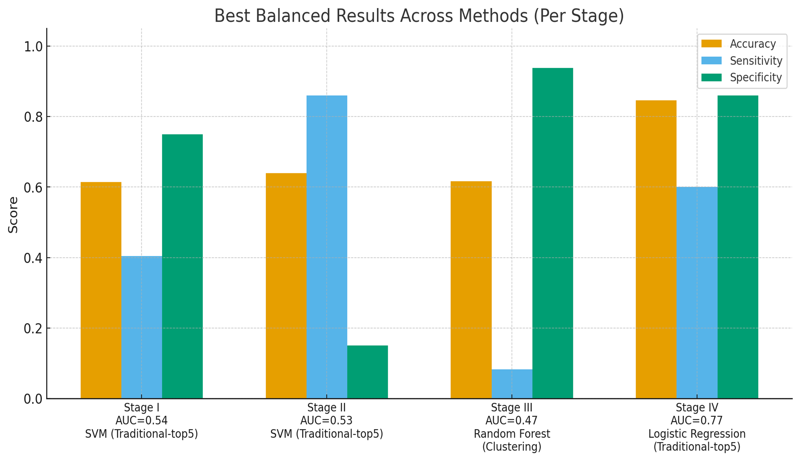
Classification Results
Best Results Across Methods:
Stage I: 61.4% (Traditional-top5 + SVM)
Stage II: 64.0% (Traditional-top5 + SVM)
Stage III: 61.7% (Clustering + RF)
Stage IV: 84.6% (Traditional-top5 + LR)
Key Insights:
Traditional methods showed the most consistent performance at our data scale (high dimensionality, limited samples, class imbalance).
Different selectors capture complementary miRNA signals, reinforcing the value of consensus approaches for managing selector variability.

Slide 6
What is next?
Cross-reference identified miRNAs with published breast cancer biomarker studies to validate biological relevance of top consensus miRNAs.
Final Report & Documentation
Comprehensive results and method comparison. Discussion of class imbalance impact (especially Stage IV). Recommendations for improving performance and future research directions.
Program
Deliver well-documented, reproducible code with all outputs and analysis pipelines.
Literature Validation

